Slide 1
DID GAZA PROTESTS
COST HARRIS THE 2024 ELECTION?
A Three-Part Empirical Analysis
Applied Political Analytics
By Maxx Margob

Slide 2
THE CLAIM
“DNC's own data found [Gaza policy] was,
in their words, a 'net-negative' in the 2024 election.”
— Axios, February 22, 2026 (citing DNC autopsy)
Evidence cited:
100k+ uncommitted votes in Michigan primary
Campus protest movement visibility
Arab American community anger in Dearborn

Slide 3
THREE-PART ANALYTICAL APPROACH
01
02
03
County-Level
ANES 2024
ANES Panel
3,116 counties
Protest × swing regression
Robustness checks
2,245 Biden voters
Gaza attitude predictors
Survey-weighted logit
Same voters 2020–2024
Attitude change scores
Longitudinal logit

Slide 4
DATA SOURCES
MIT Election Data & Science Lab
County-level presidential returns 2020–2024
Crowd Counting Consortium (CCC)
Gaza protests Oct 2023 – Nov 2024, n = 490 counties
ACS 2024 (2021 for CT)
Education, race, income, age demographics
ANES 2024 Time Series
N = 2,073 Biden 2020 voters, complex survey weights
ANES 2016–2020–2024 Panel
N = 2,839 tracked respondents across 3 elections
Alaska excluded (incompatible geographies). Connecticut uses 2021 ACS.

Slide 5
PART ONE
County-Level Analysis
3,116 Counties · Protest Intensity · Electoral Swing

Slide 6
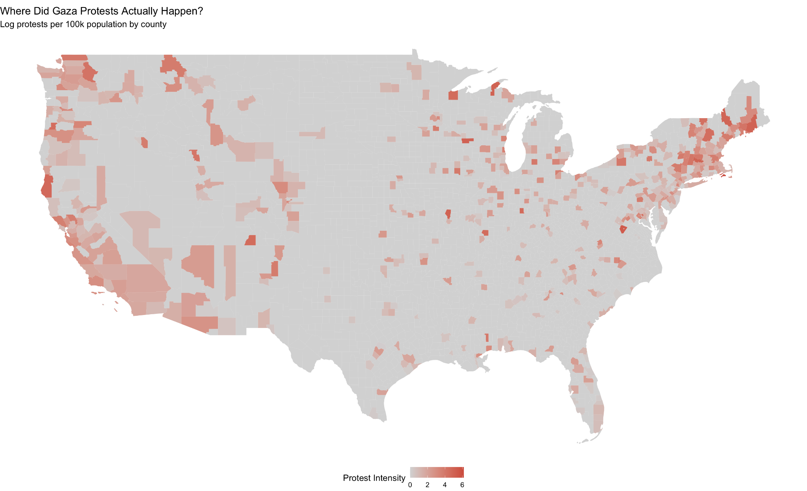
WHERE DID PROTESTS HAPPEN?
490
Counties with
any protests
[INSERT: Protest intensity map — log protests per 100k by county]
15.7%
of all U.S.
counties
84.3%
had ZERO
protest activity

Slide 8
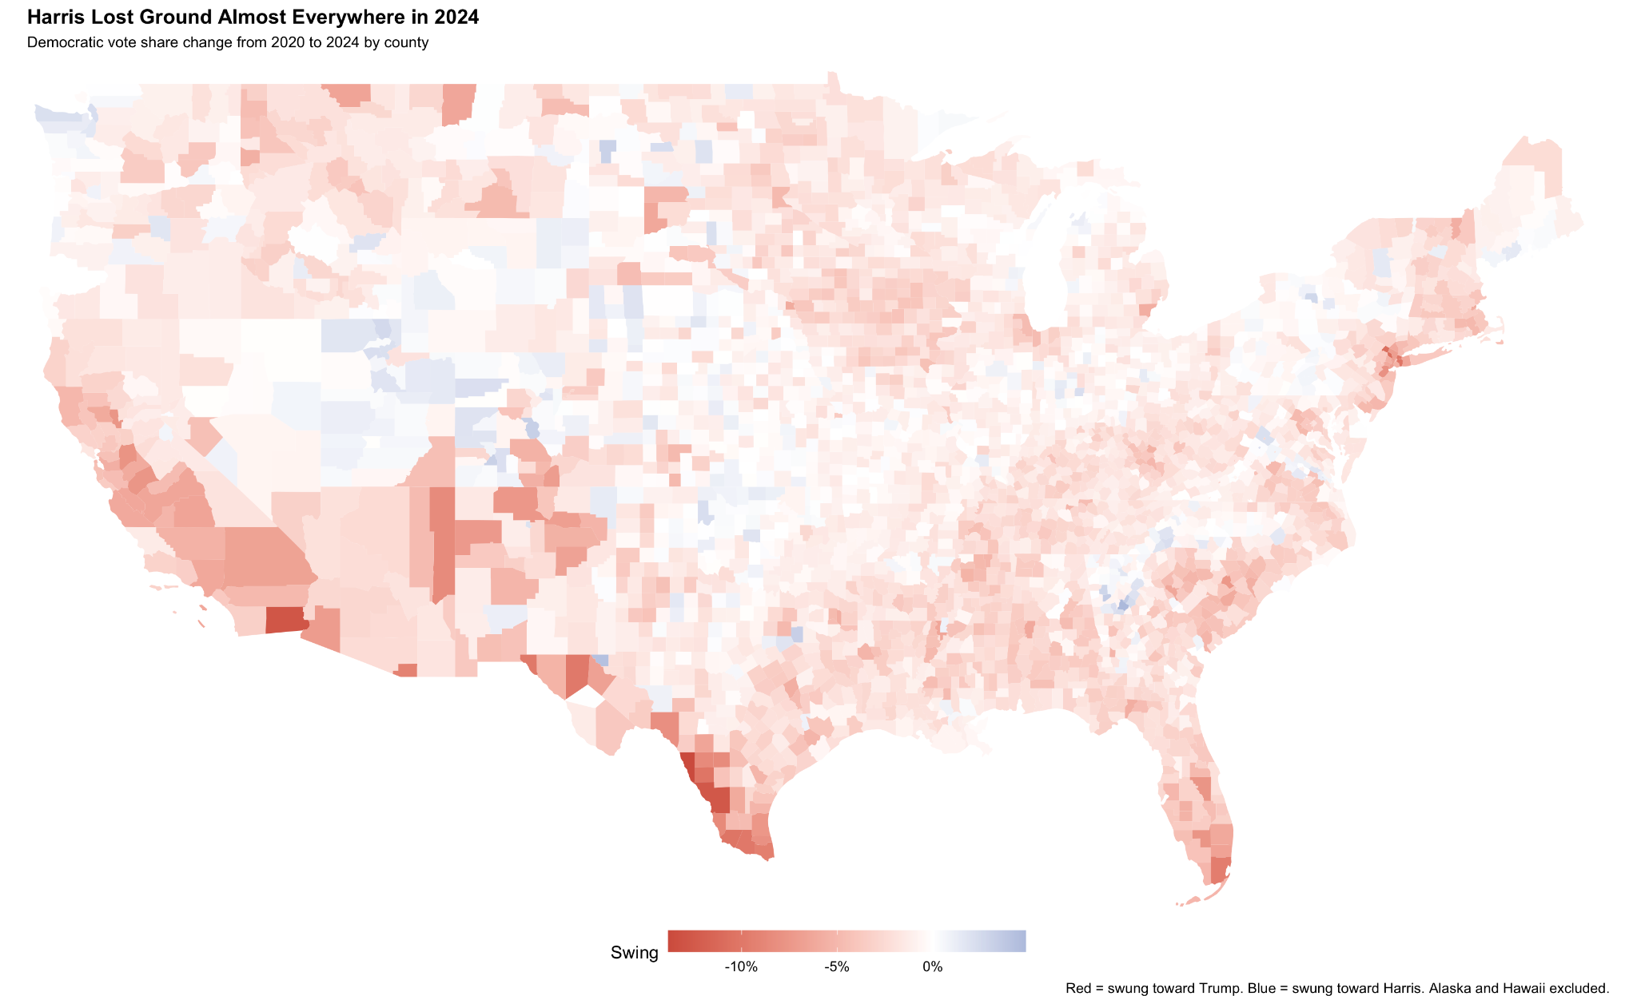
HARRIS LOST GROUND ALMOST EVERYWHERE
The swing was national and broad — not concentrated in protest hotspots.

Slide 10
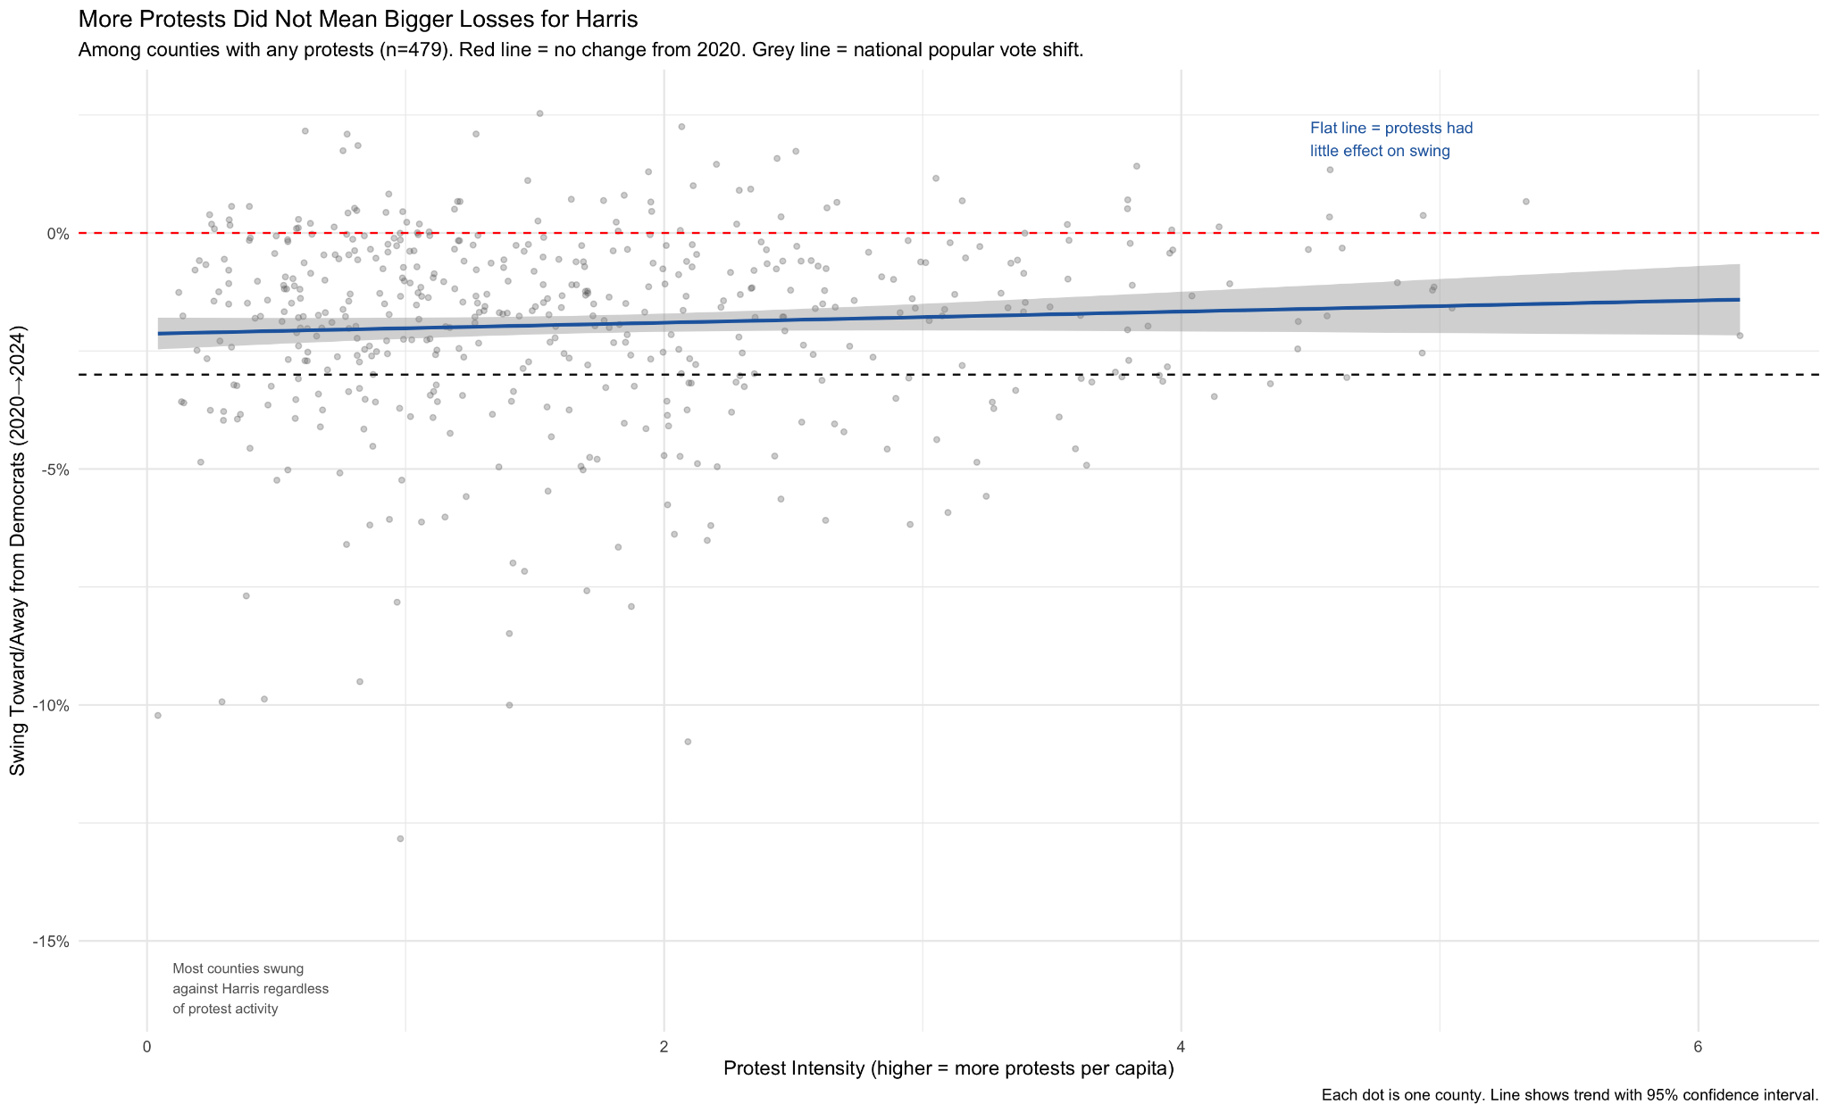
MORE PROTESTS ≠ BIGGER LOSSES
[INSERT: Scatter plot — log_protests (x) vs dem_shift_24_20 (y)
With flat trend line and annotations]
Among 479 counties with any protests. Flat line = protest intensity had little effect on swing.

Slide 12
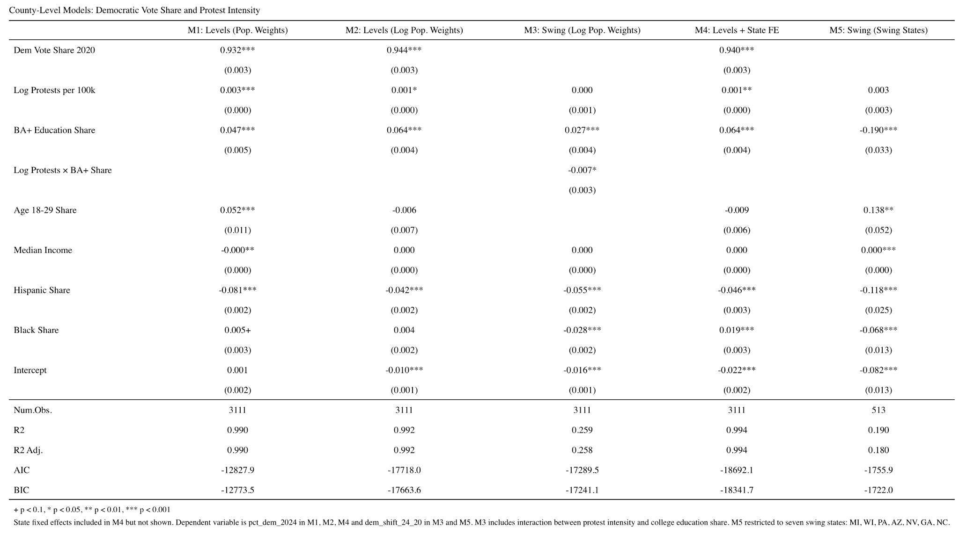
COUNTY REGRESSION RESULTS
Key Findings
Protest effect near zero in swing model
No dose-response across Low/Med/High
Effect vanishes in swing states
Hispanic/Black share stronger predictors

Slide 14
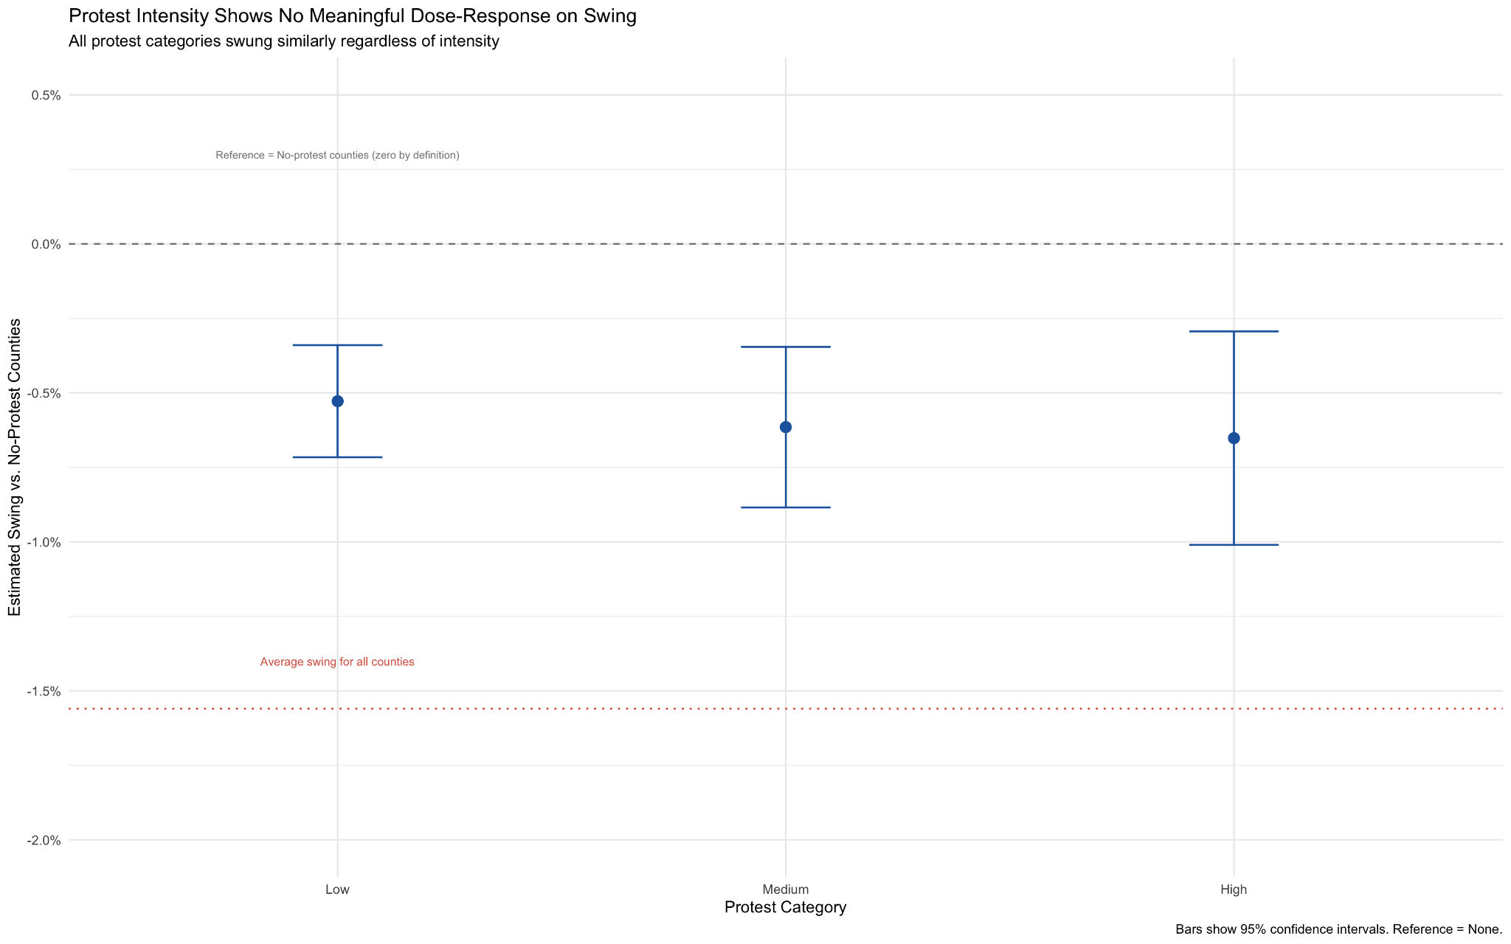
NO DOSE-RESPONSE: ROBUSTNESS CHECK
If protests caused losses, higher intensity → larger swing.
All three categories are nearly identical.
The pattern is flat.

Slide 16
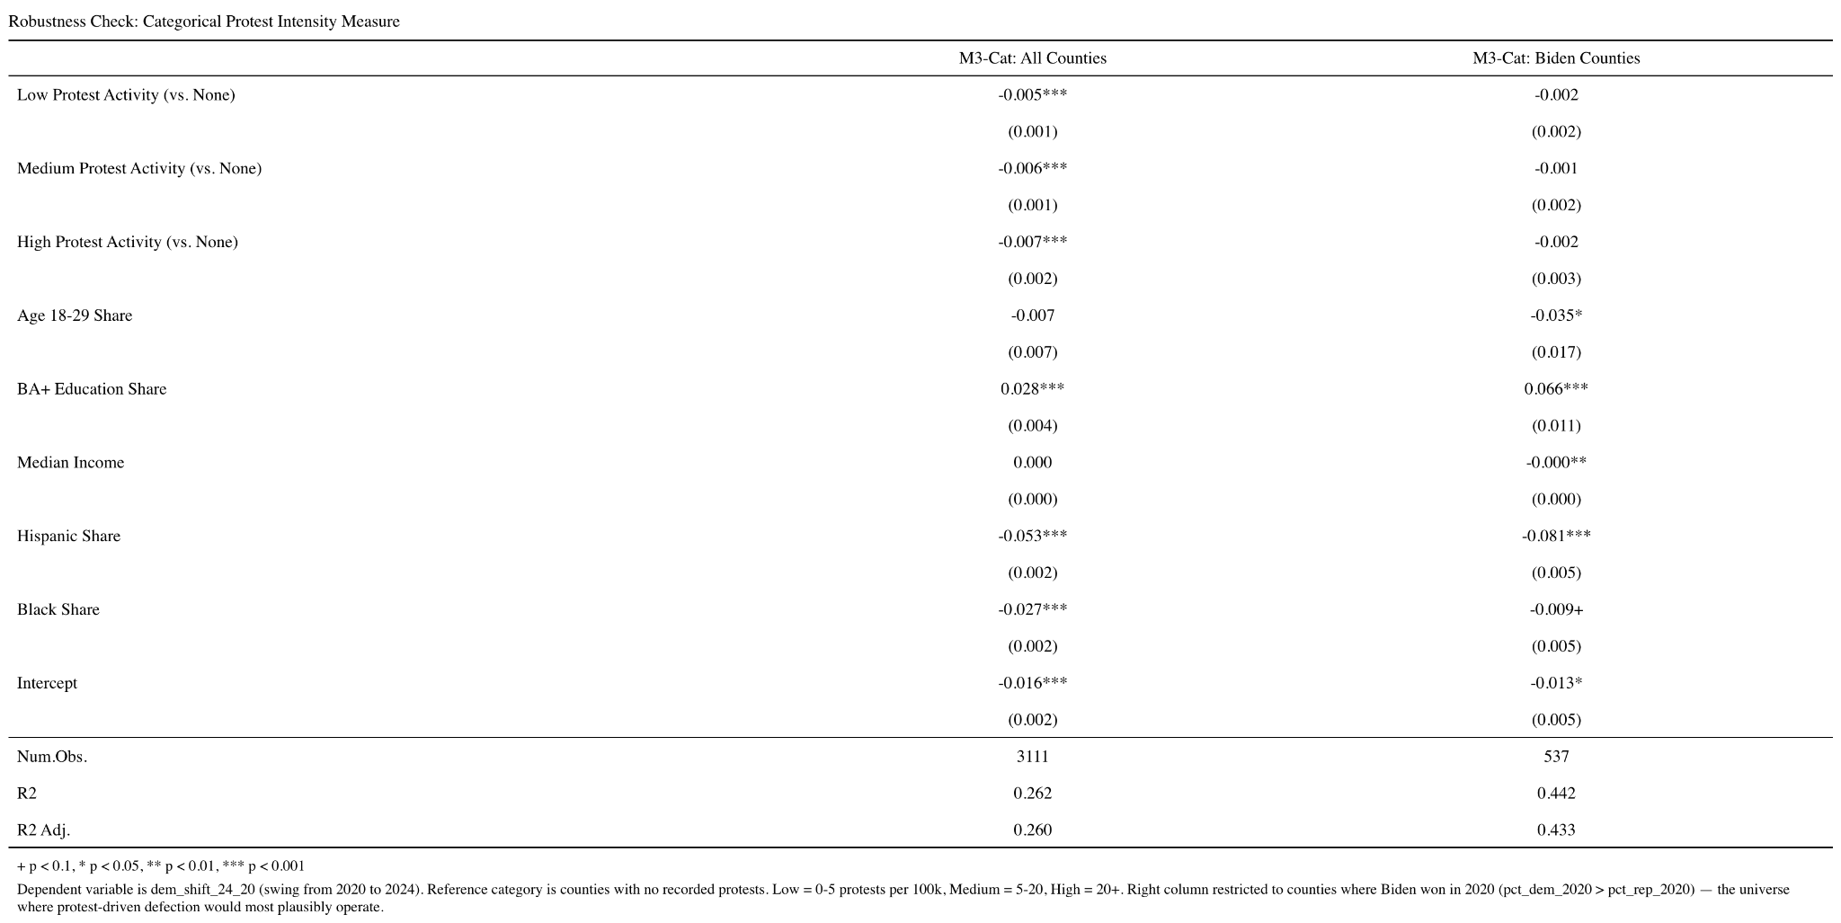

Slide 17
PART TWO
Individual-Level: ANES 2024
Did Gaza attitudes predict who defected from Harris?

Slide 18
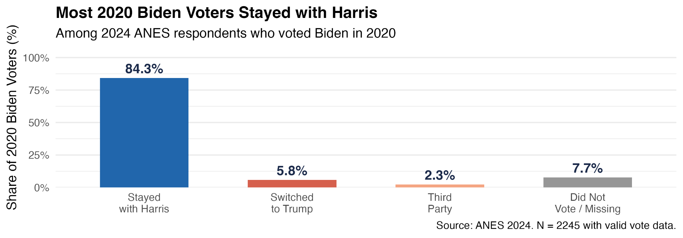
WHO WERE THE DEFECTORS?
2,245
181
8.1%
2020 Biden voters
in ANES sample
Defected from
Harris in 2024
Defection
rate
Defection breakdown (where did they go?):

Slide 19
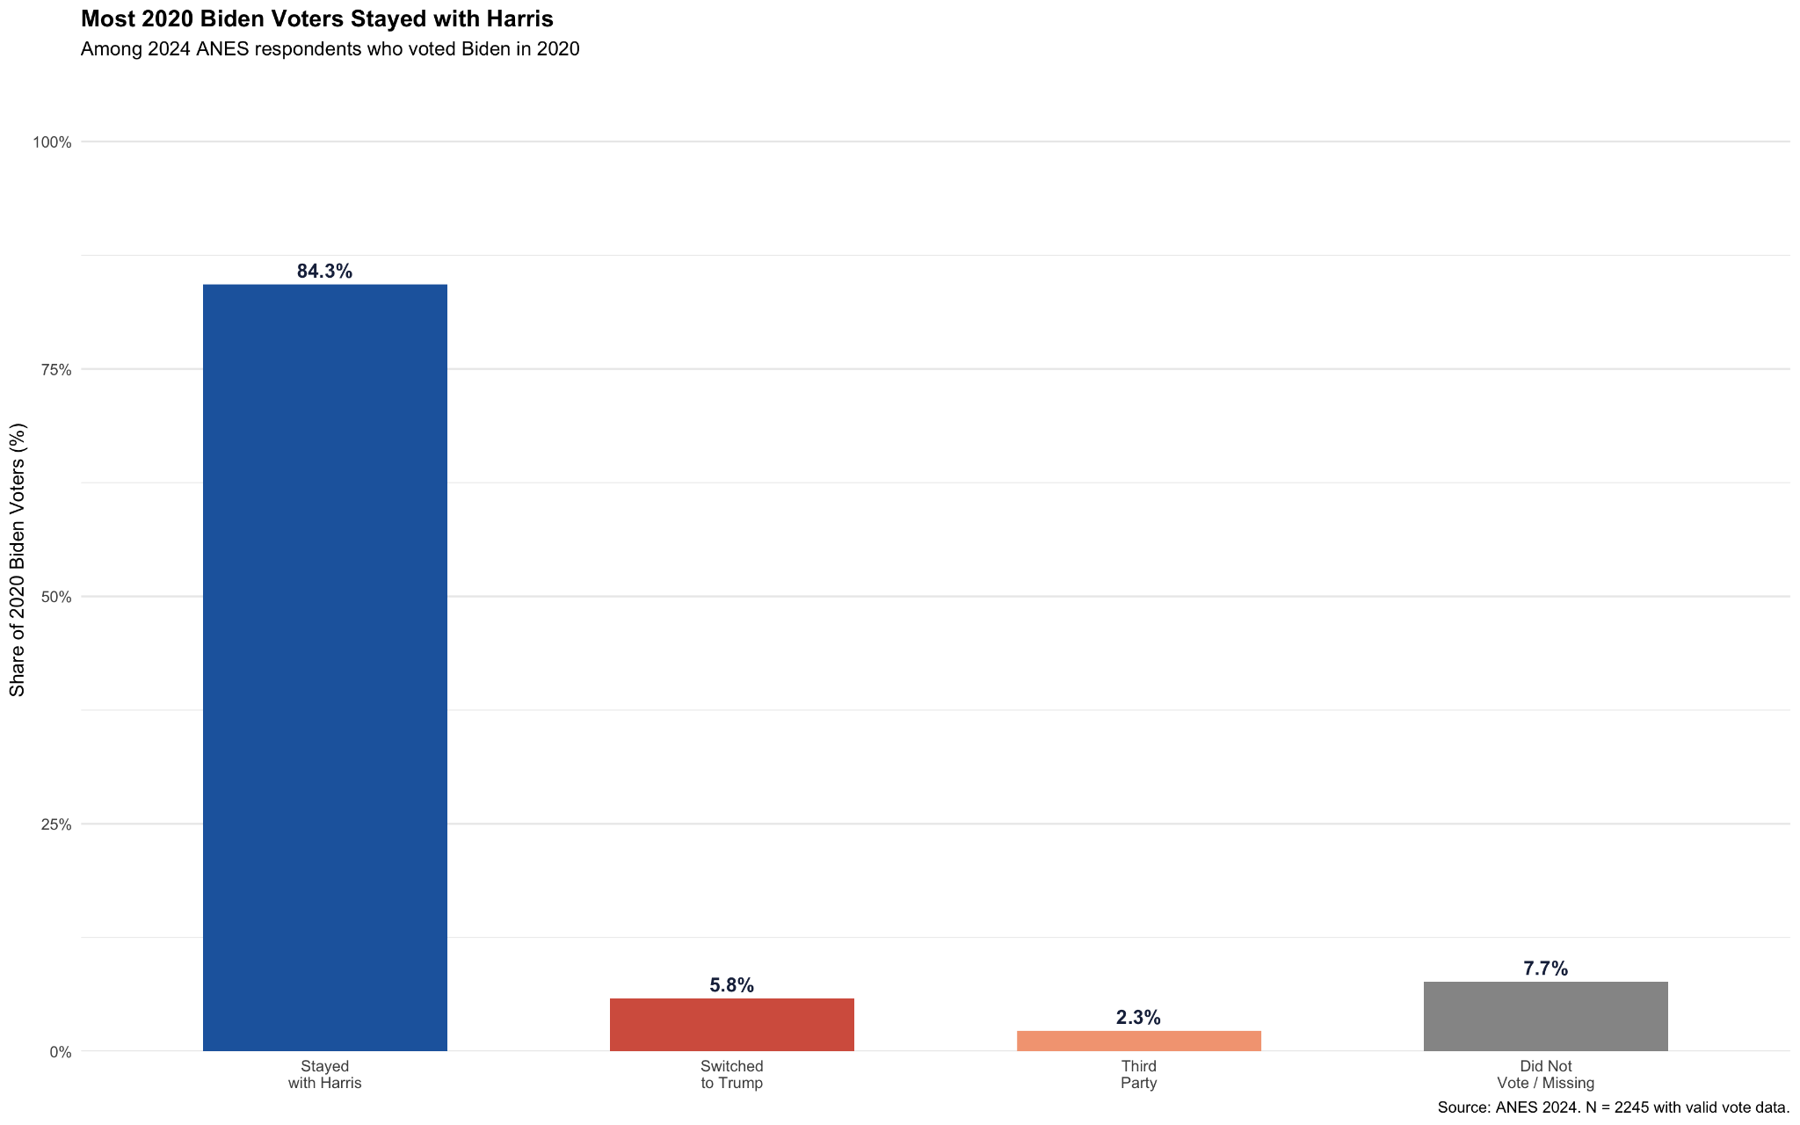

Slide 20
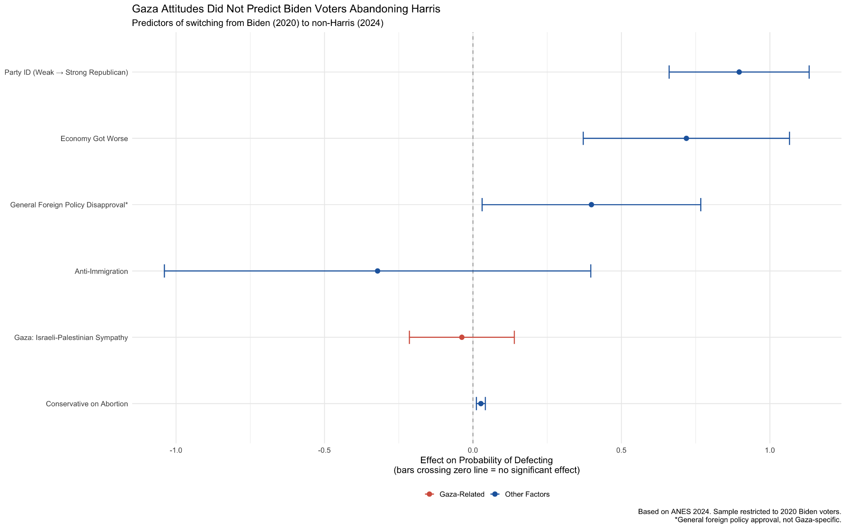
GAZA ATTITUDES DID NOT PREDICT DEFECTION
Bars crossing the zero line = no statistically significant effect on defection.

Slide 22
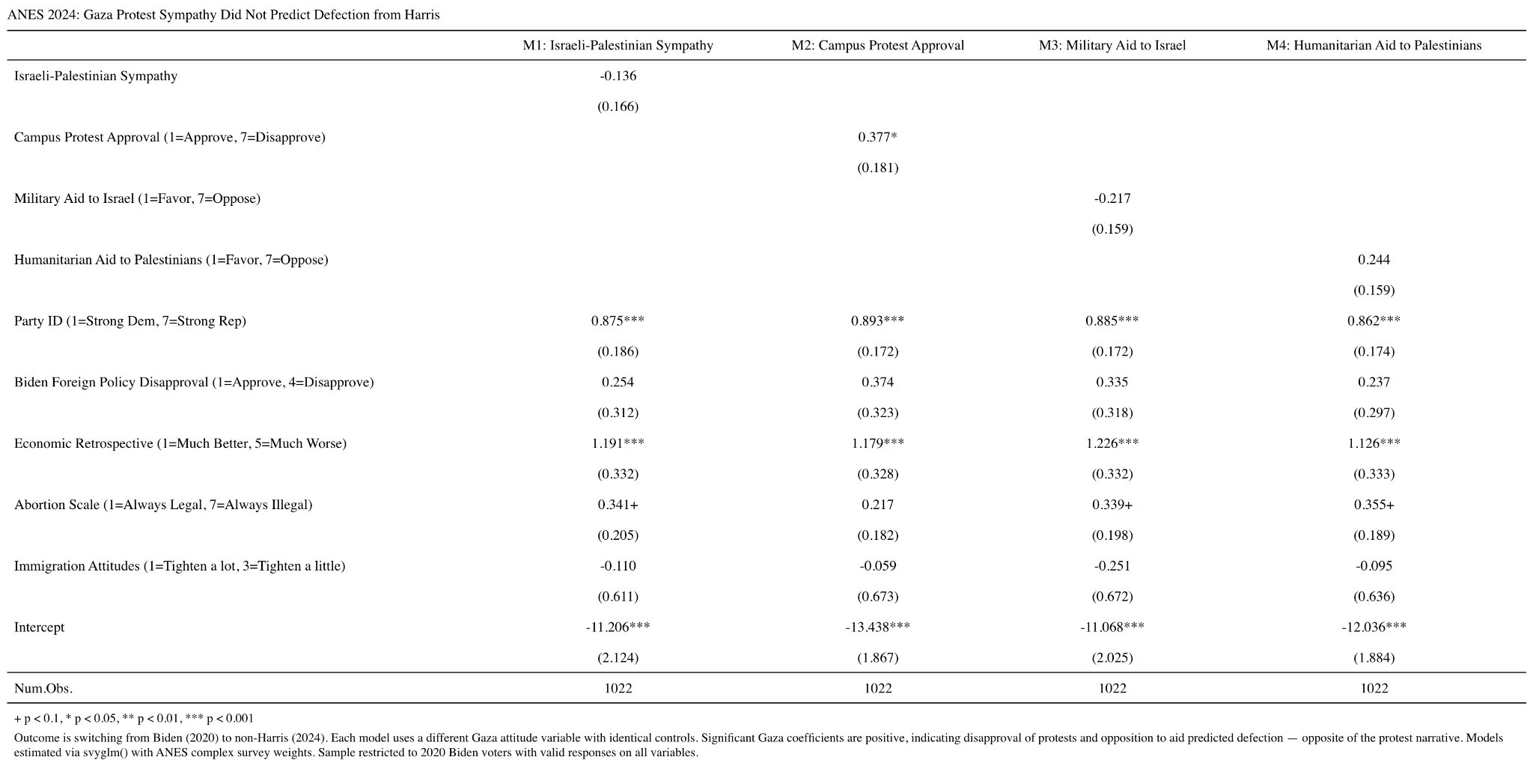

Slide 23
PART THREE
Longitudinal Panel Analysis
Tracking the same voters across 2020 and 2024

Slide 24
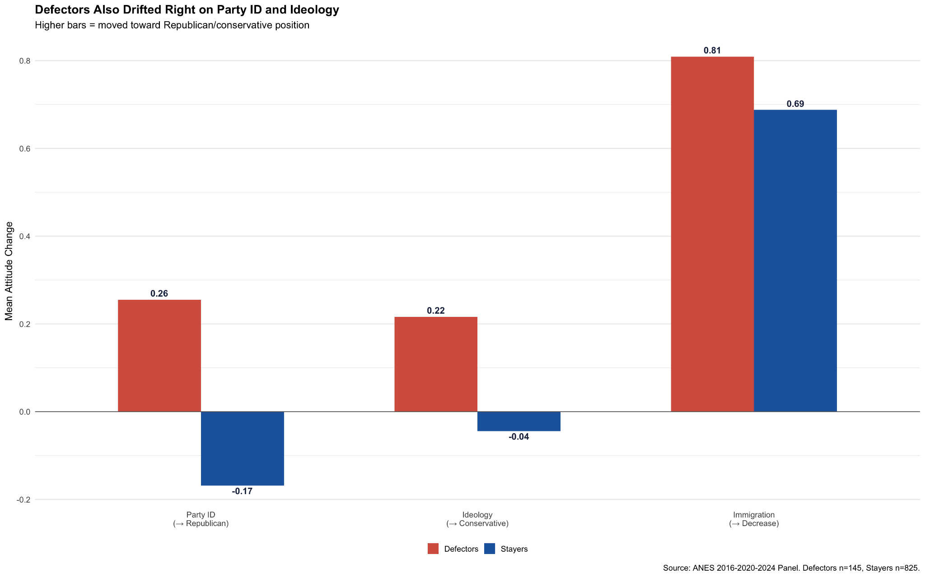
WHAT CHANGED BETWEEN 2020 AND 2024?
Critical Point
These attitude shifts were accumulating across 2020–2024.
Gaza began Oct 2023.
The forces driving defection predate the conflict.

Slide 26
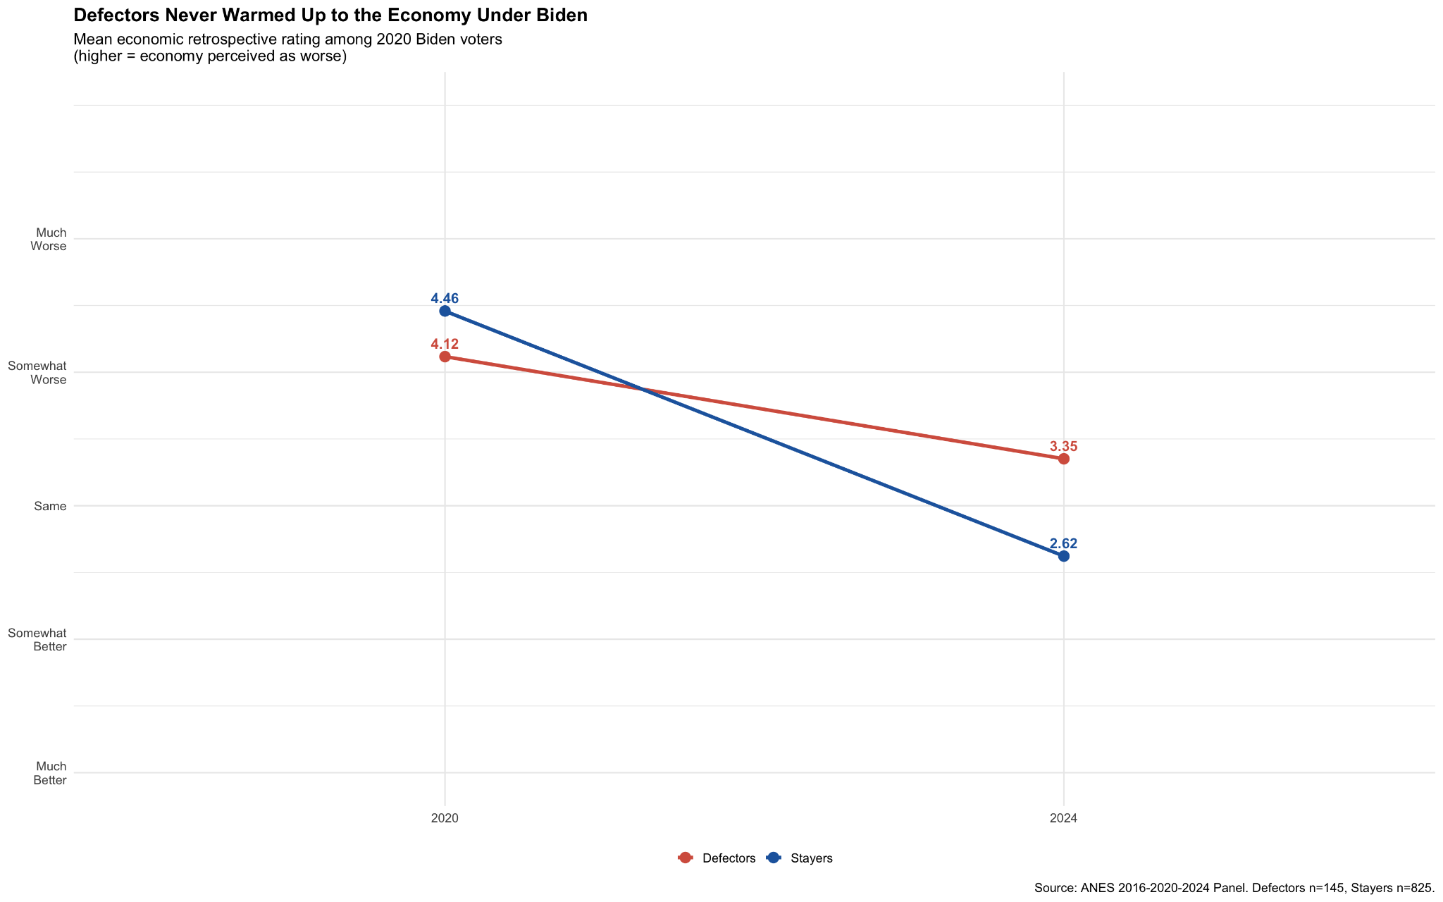

Slide 27
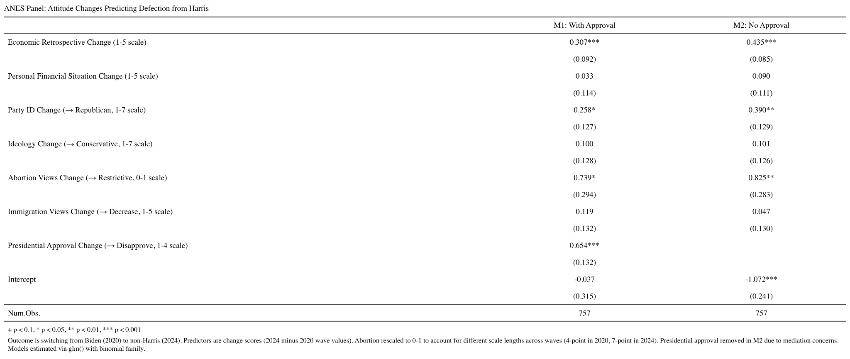

Slide 28
PANEL REGRESSION: WHAT PREDICTED DEFECTION?
SIGNIFICANT
NOT SIGNIFICANT
Economy perceived as worsening (p<.001)
Party ID shift toward Republican (p=.002)
Abortion views shift more restrictive (p=.004)
Ideology change
Immigration attitudes
Personal financial situation
ANES
Wave 1
Biden
Wins
COVID
Recovery
Inflation
Peak
Gaza
Begins
Harris
Loses
Jan 2020
Nov 2020
May 2021
Late 2021–23
Oct 2023
Nov 2024
Economic pessimism was building well before Gaza began.

Slide 29
WHAT ACTUALLY DROVE HARRIS'S LOSS?
Economic Dissatisfaction
Partisan Dealignment
Consistent predictor at county
and individual level
Weak Democrats defected;
strong Democrats stayed
Hispanic Vote Erosion
Abortion Realignment
Strongest county-level
predictor of swing
Some Biden voters were
never fully aligned

Slide 30
ACTION ITEMS
For Democratic Campaigns
For Political Analysts
For the DNC
Stop relitigating Gaza narrative
Focus on economic messaging early
Invest in Hispanic coalition retention
Apply empirical scrutiny to protest claims
Visible events ≠ causal mechanisms
Release the full autopsy report
Hispanic erosion is the real structural problem
Economic credibility must come first

Slide 31
CONCLUSION
The data does not support the claim.
County Level
ANES 2024
ANES Panel
No protest effect
in swing states
Gaza attitudes
not significant
Defection forces
predated Gaza
Harris lost because of economic dissatisfaction, partisan dealignment,
and coalition erosion, not because of Gaza protests.

